Slide 1


Exercice 1:
Solution:

Slide 2
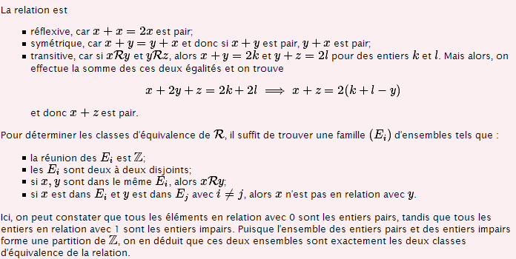
Exercice 2:
Solution:

Slide 3


Exercice 3:
Solution:

Slide 4

Exercice 4:

Slide 5
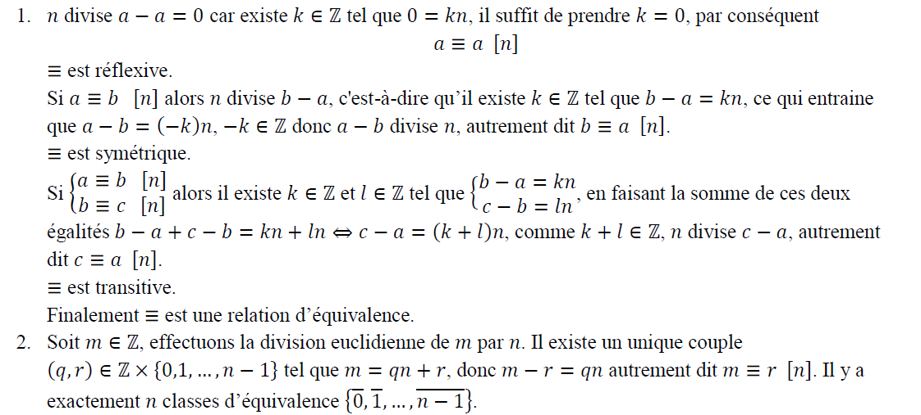
Solution:

